Slide 1
Objective of the course

Slide 2
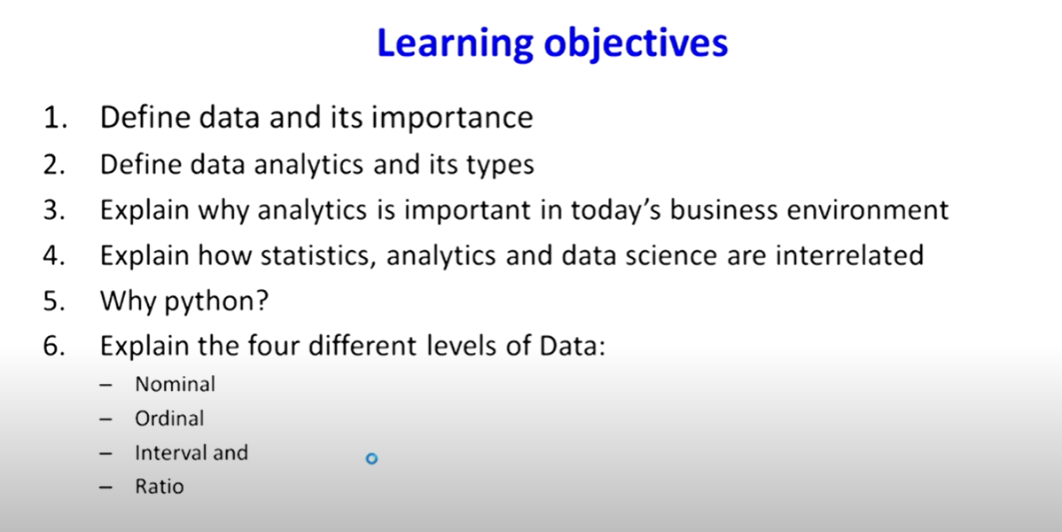

Slide 3
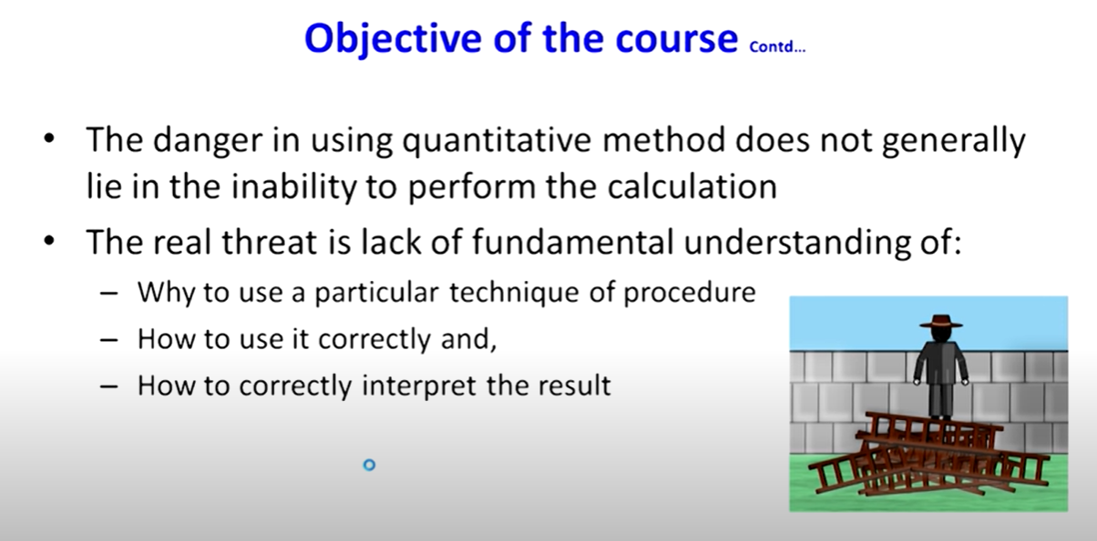

Slide 4
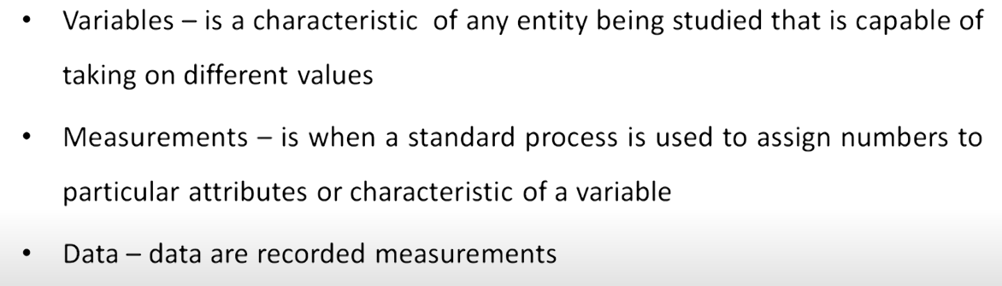
Variable, Measurement and Data

Slide 5
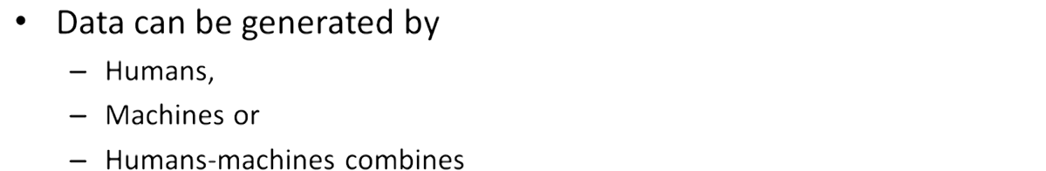
What is generating so much Data

Slide 6
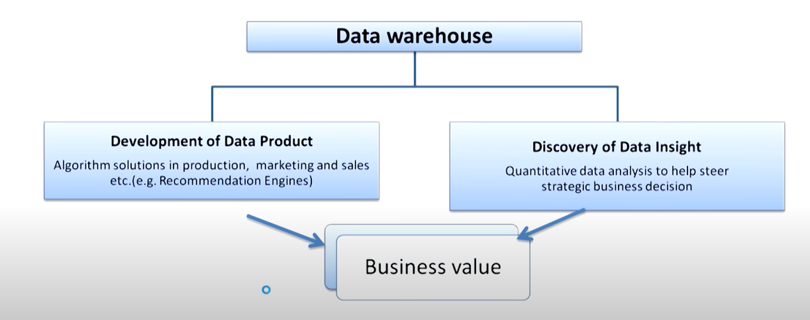
How data add value to business

Slide 7

Data Products

Slide 8
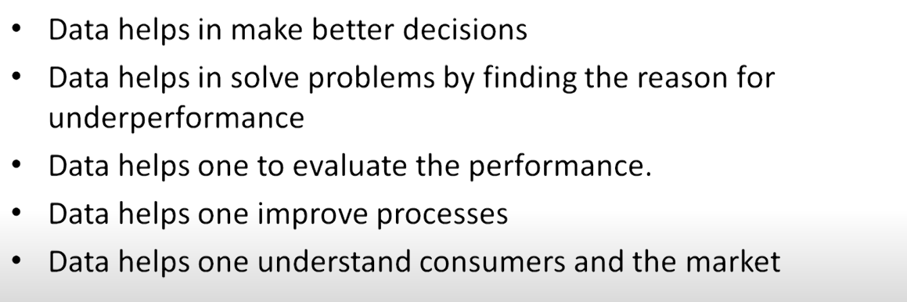
Why Data is important

Slide 9
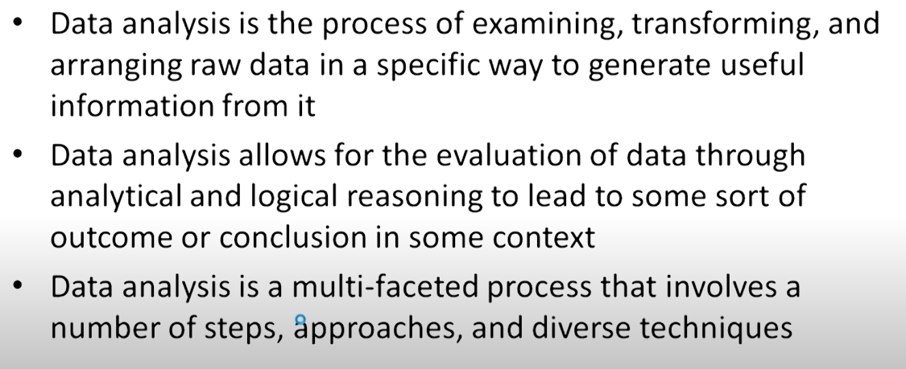
Data Analysis

Slide 10
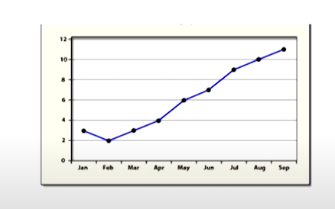
Data Analysis Vs Data Analytics
Data Analysis:will tell us what has happened in the past, how it happened.
It is a kind of postpartum analysis of what had happened in the past.

Slide 11
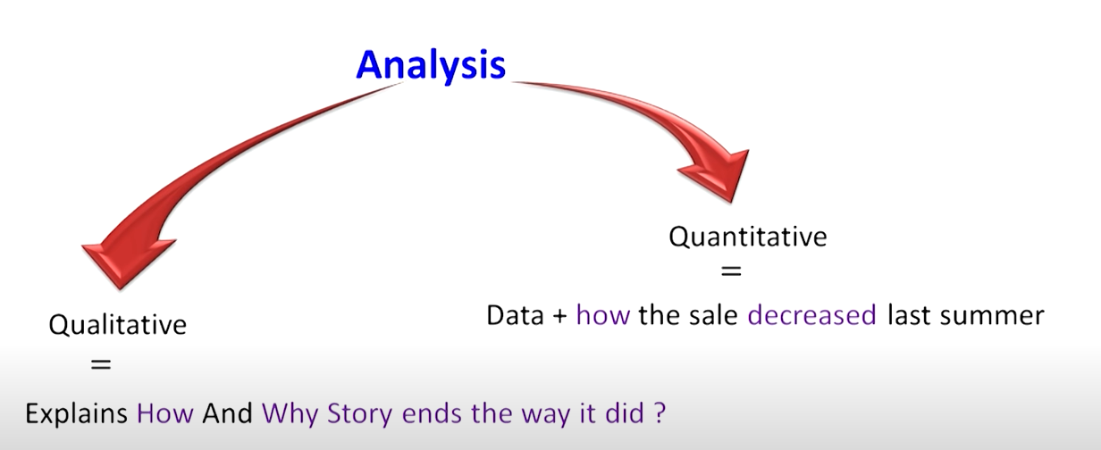
Data Analytics: is what will happen in future.It is to explore future events.

Slide 12
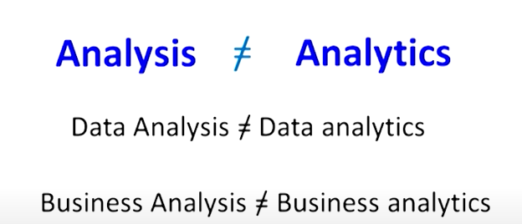
Business Analytics is study of future events based on past data

Slide 13
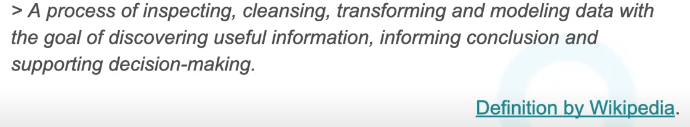
Data Analysis

Slide 14
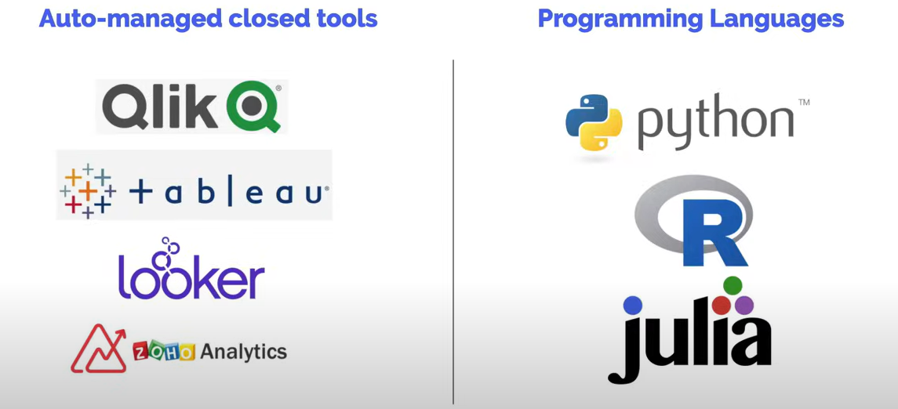
Data Analysis Tools

Slide 15
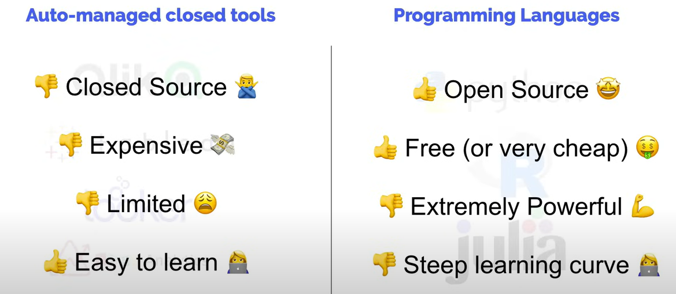

Slide 16
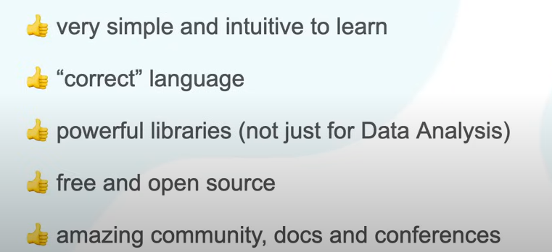
Why python for Data Analysis

Slide 17
Data Analysis Process

Slide 18
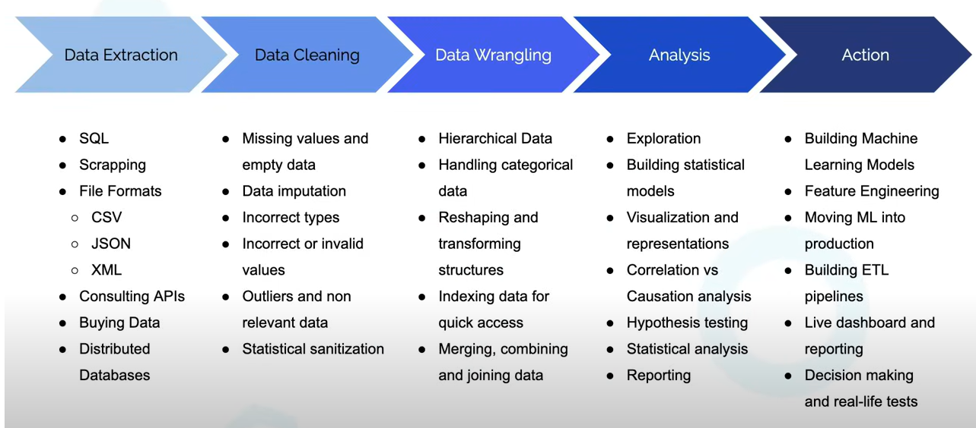

Slide 19
Data Extraction:
Data extraction is the act or process of retrieving data out of data sources for further data processing or data storage.
Data cleaning
Data cleaning is the process of fixing or removing incorrect, corrupted, incorrectly formatted, duplicate, or incomplete data within a dataset.
Data Wrangling
Data Wrangling is the process of gathering, collecting, and transforming Raw data into another format for better understanding, decision-making, accessing, and analysis in less time

Slide 20
Data cleaning is the process of making sure that the data is accurate and consistent, while data wrangling is the process of manipulating the data to make it usable for analysis. Both steps are essential for the process of working with data, and they need to be performed before any analysis takes place.
Data Analysis: Data analysis is the process of inspecting, cleansing, transforming, and modeling data with the goal of discovering useful information, informing conclusions, and supporting decision-making.

Slide 21
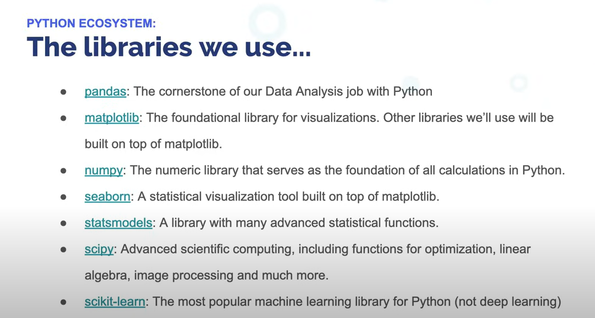

Slide 22

Python Variables
Variables are containers for storing data values.
Python has no command for declaring a variable.
A variable is created the moment you first assign a value to it.
Variables do not need to be declared with any particular type, and can even change type after they have been set.

Slide 23


Casting If you want to specify the data type of a variable, this can be done with casting.

Slide 24
Variable Names
A variable can have a short name (like x and y) or a more descriptive name (age, carname, total_volume). Rules for Python variables:A variable name must start with a letter or the underscore character
A variable name cannot start with a number
A variable name can only contain alpha-numeric characters and underscores (A-z, 0-9, and _ )
Variable names are case-sensitive (age, Age and AGE are three different variables)
A variable name cannot be any of the Python keywords.

Slide 25
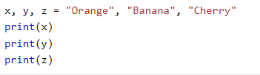
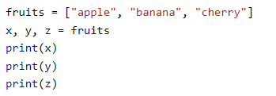
Many Values to Multiple Variables
Unpack a Collection
If you have a collection of values in a list, tuple etc. Python allows you to extract the values into variables. This is called unpacking.

Slide 26
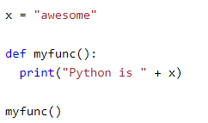
Global and local Variables
Global Variables:
Variables that are created outside of a function (as in all of the examples above) are known as global variables.
Global variables can be used by everyone, both inside of functions and outside.

Slide 27
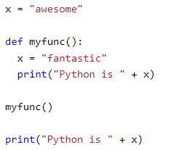
Local Variables

Slide 28
Python operators
Python divides the operators in the following groups:
Arithmetic operators
Assignment operators
Comparison operators
Logical operators
Identity operators
Membership operators
Bitwise operators

Slide 29
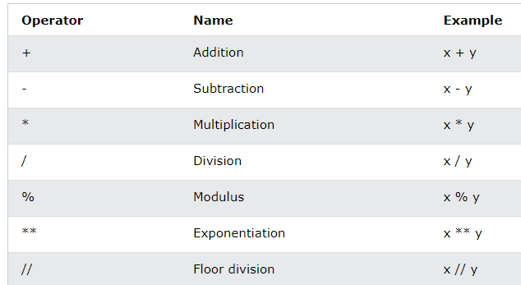
Python Arithmetic Operators

Slide 30
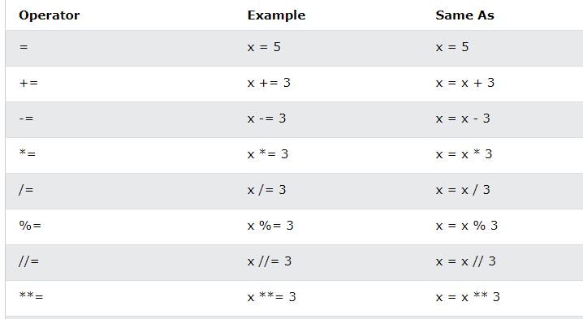
Python Assignment Operators

Slide 31
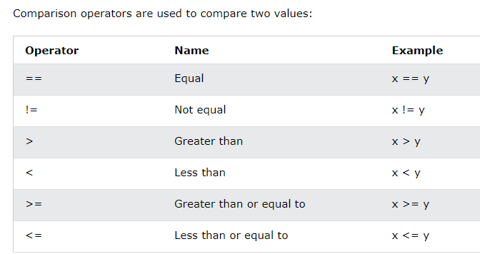
Python Comparison Operators

Slide 32
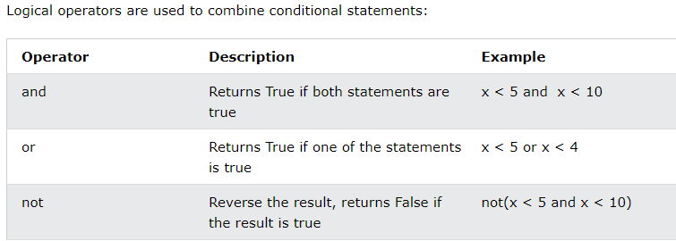
Python Logical Operators

Slide 33
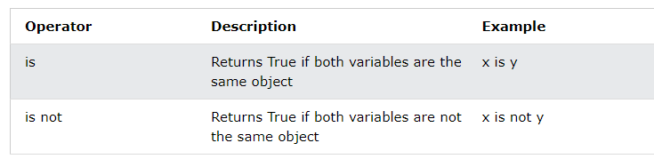
Python Identity Operators
Identity operators are used to compare the objects, not if they are equal, but if they are actually the same object, with the same memory location:

Slide 34
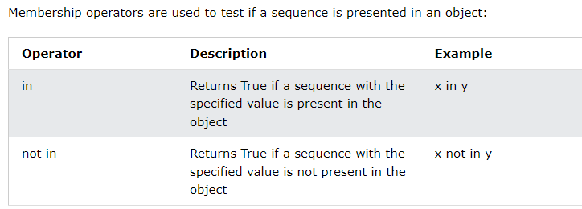
Python Membership Operators

